Slide 1


Forage Accenture Project Task3

Slide 2


Today's agenda
Project recap
Problem
The Analytics team
Process
Insights
Summary

Slide 3

uuhhkj
Client name: Social Buzz
Client industry: Social media & content creation
Year established: 2010
Location of HQ: San Francisco
Social Buzz is a social media & content creation company which emphasizes content by keeping all users anonymous, only tracking user reactions on every piece of content. There are over 100 ways that users can react to content, spanning beyond the traditional reactions of likes, dislikes, and comments. This ensures that trending content, as opposed to individual users, is at the forefront of user feeds.
Over the past 5 years, Social Buzz has reached over 500 million active users each month. They have scaled quicker than anticipated and need the help of an advisory firm to oversee
their scaling process effectively.
Project Recap

Slide 4

Problem
Social Buzz has reached over 500 million active users each month.
Every day over 100,000 pieces of content, ranging
from text, images, videos and GIFs are posted.
Here they don’t have enough employee to capitalize this ever-growing content data.
Task is to find out important information about the content data so that they can focus on most important contents on their platform.

Slide 5

Process
1
Data Understanding
2
Data Cleaning
3
Data Modeling
4
Data Analysis
5
Insights Sharing

Slide 6

Insights
There are four Content Type Audio, GIF, Photo & Video across 16 different Categories in which Video has the most Reaction Score followed by Photo, GIF and Audio.
In Late Night most of the users are active almost 30% of total as well as it is observed almost all the users are active all the phase of Day Morning, Afternoon, Evening, Late Evening & Late night once.
There are 16 Reaction Types and 3 Reaction Type Sentiments for different contents.
December has the highest reaction score which is almost flat for all other months as well as Technology has the highest score in Category.
Reaction Type Sentiment is Positive more than 84% of times and Neutral and Negative are 8.73% and 6.54% times respectively.

Slide 7
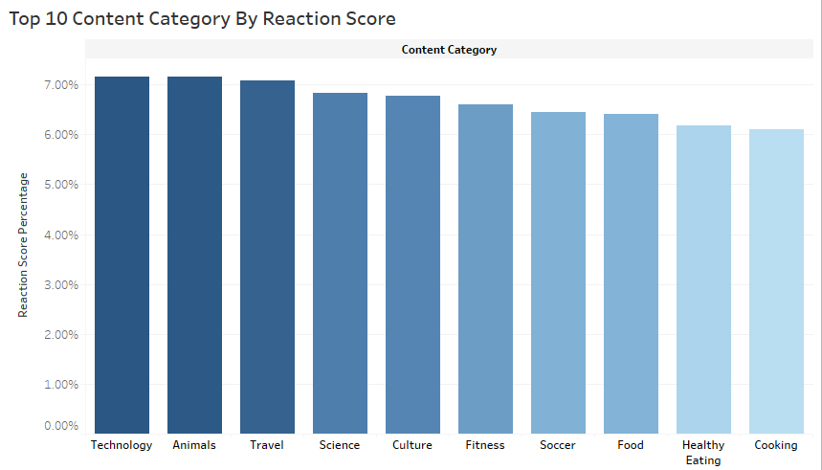

Slide 8
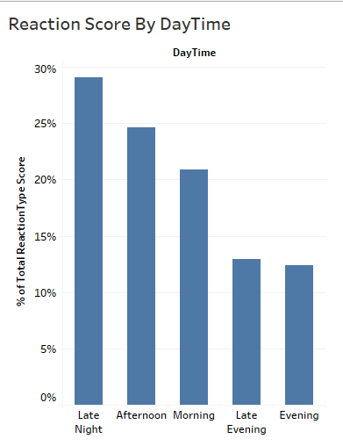
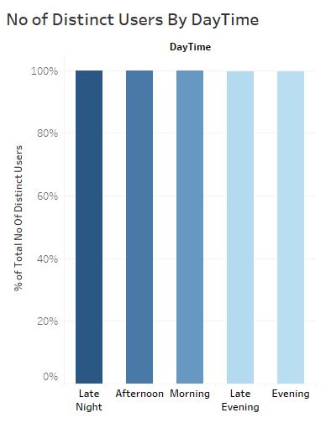
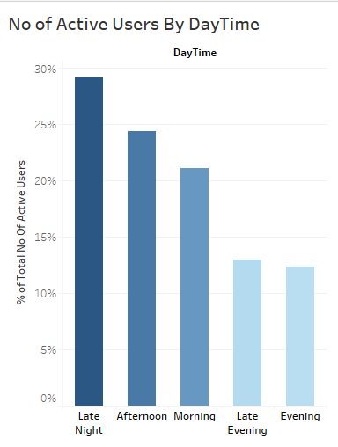

Slide 9
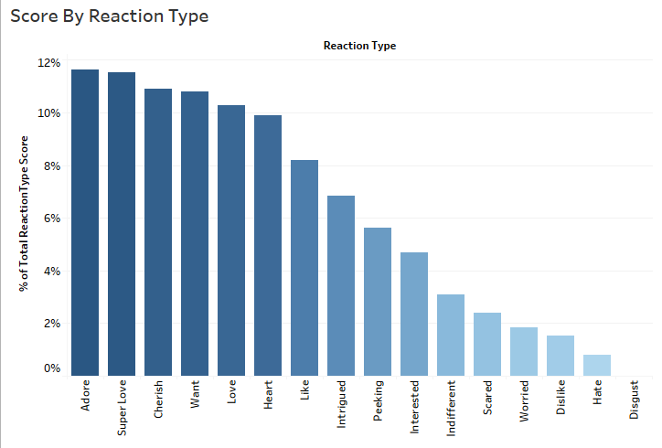

Slide 10

Most of the users are active during Late Night and Afternoon sessions during 00:00 AM to 06:00 AM and from 12:00 PM to 06:00 PM.
Top 5 Categories are Technology, Animals, Travel, Science and Culture.
Summary

Slide 11
Thank you!
ANY QUESTIONS?

